Slide 1
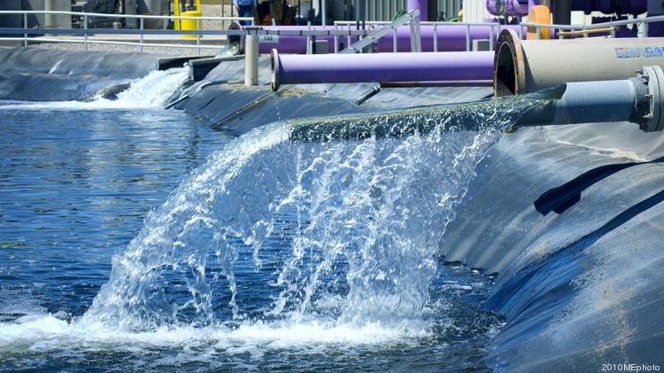

American Water
Terms Extension Opportunity Assessment June 24

Slide 2
Based on the provided images, here is a comprehensive summary for American Water:
---
**Situation Summary for American Water**
We understand that American Water is looking to optimize its working capital position with Taulia’s holistic Working Capital Management platform. Taulia analyzed American Water’s supplier relationships and spend to highlight the working capital trapped within its supply chain.
**Highlights:**
* **Working Capital Opportunity:**
* Total potential working capital within American Water’s existing supply chain is ~$250M based on 100% extension adoption.
* **Impact to Discounts:**
* Significant discount potential with peak liquidity demand at APR 6 and $1.4M gross yield.
* **Industry Analysis:**
* Taulia expects American Water should be able to generate significant working capital efficiencies by aligning payment terms with industry and peer benchmarks.
By leveraging Taulia’s platform, American Water can unlock significant working capital and efficiency gains.
---
This summary fits within a single slide and provides a clear overview based on the collective analysis of the provided images.
© 2023 Taulia LLC. Confidential information. Do not distribute.

Slide 3
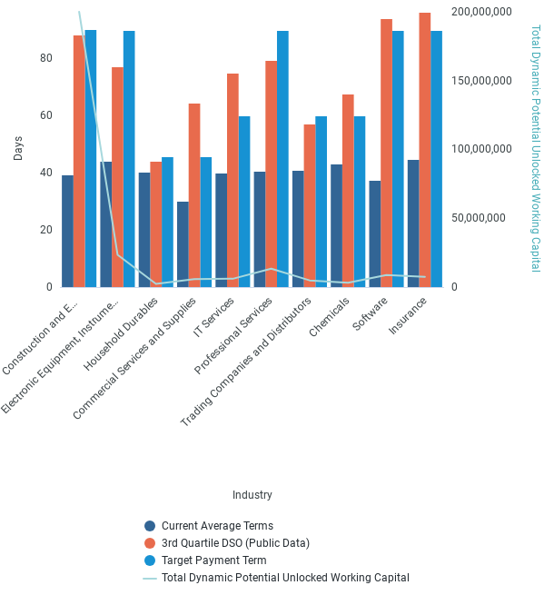
Industry Term Comparison
© 2023 Taulia LLC. Confidential information. Do not distribute.

Slide 4
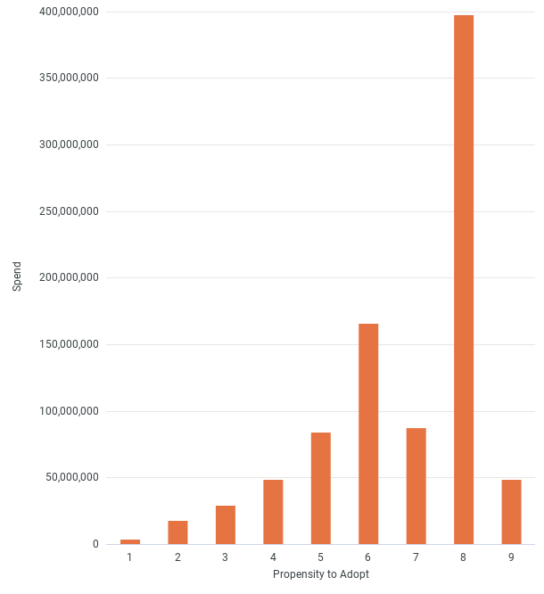
Card Adoption
© 2023 Taulia LLC. Confidential information. Do not distribute.

Slide 5
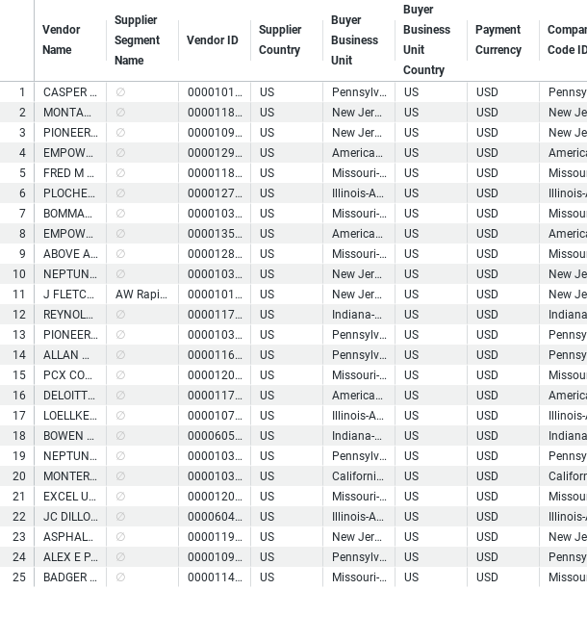
Top WC Potential Suppliers
© 2023 Taulia LLC. Confidential information. Do not distribute.

Slide 6
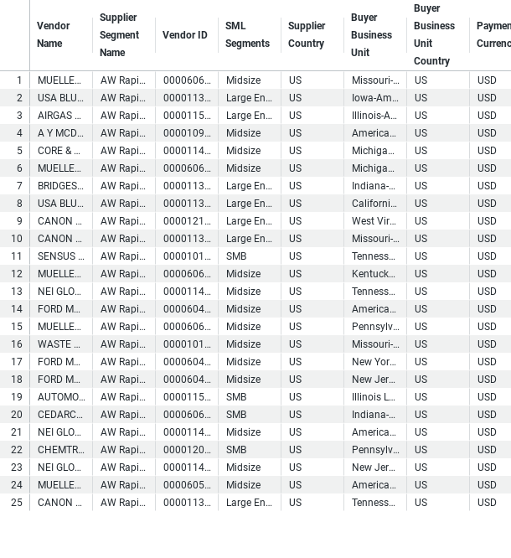
Buyer - Payables Planner Supplier List
© 2023 Taulia LLC. Confidential information. Do not distribute.

Slide 7
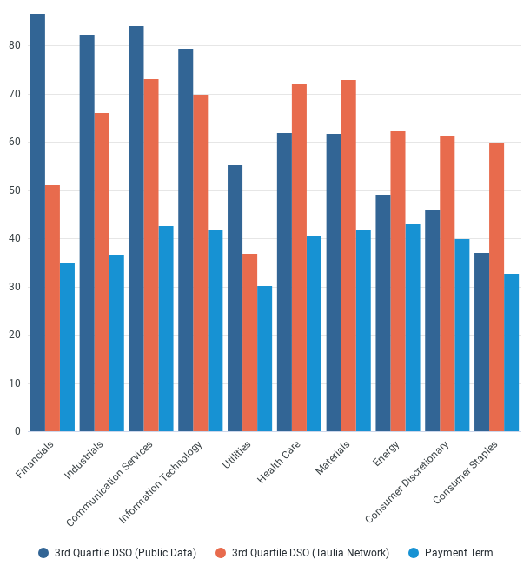
Supplier Payment Terms Comparison
© 2023 Taulia LLC. Confidential information. Do not distribute.

Slide 8
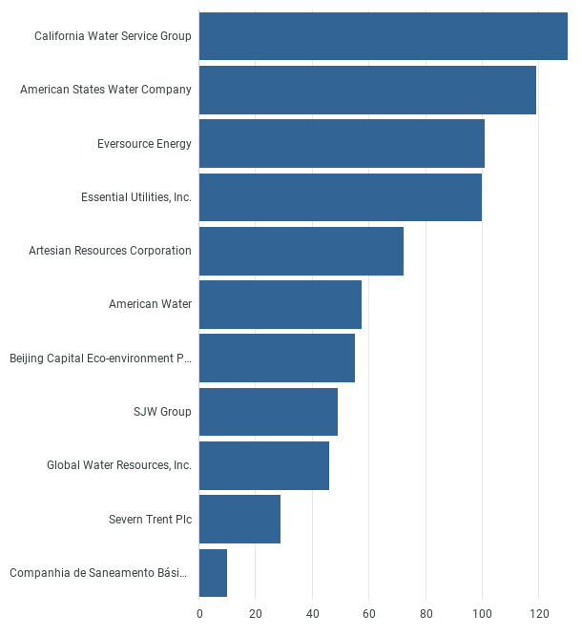
Peer DPO
© 2023 Taulia LLC. Confidential information. Do not distribute.

Slide 9
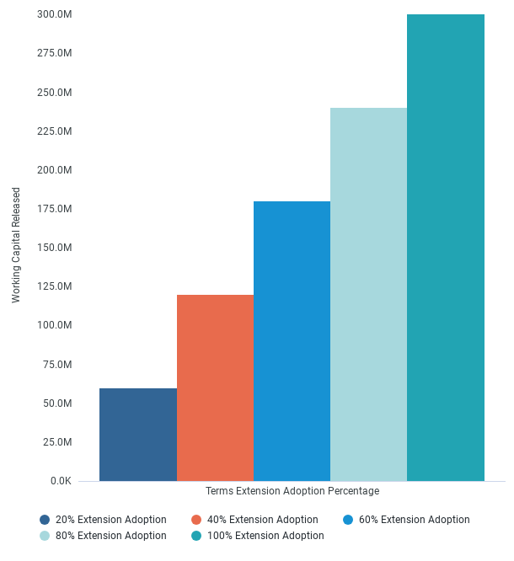
Working Capital Released
© 2023 Taulia LLC. Confidential information. Do not distribute.

